Slide 1


Class 4 Residential 2026

Slide 2

What Are the Aims of the Trip?
To have fun and try something new.
To encourage children to be active,
well-motivated learners.
To develop teamwork and social skills.
To develop confidence and self esteem.
To promote physical activity and
healthy lifestyles.

Slide 3

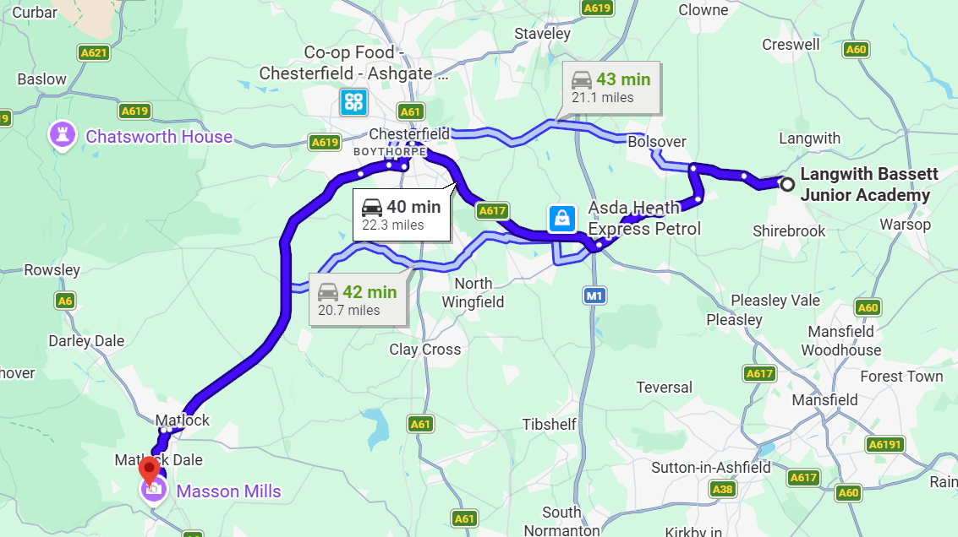
Around a 40 to 50 minute journey

Slide 4

When Is the Residential
Visit Taking Place?
The residential visit will take place on Wednesday 24th to Friday 26th June
Departing from School at 9 am to be in Matlock for 10 am
Arriving back to school at the end of the school day on the Friday leaving the residential at 2.30 pm

Slide 5
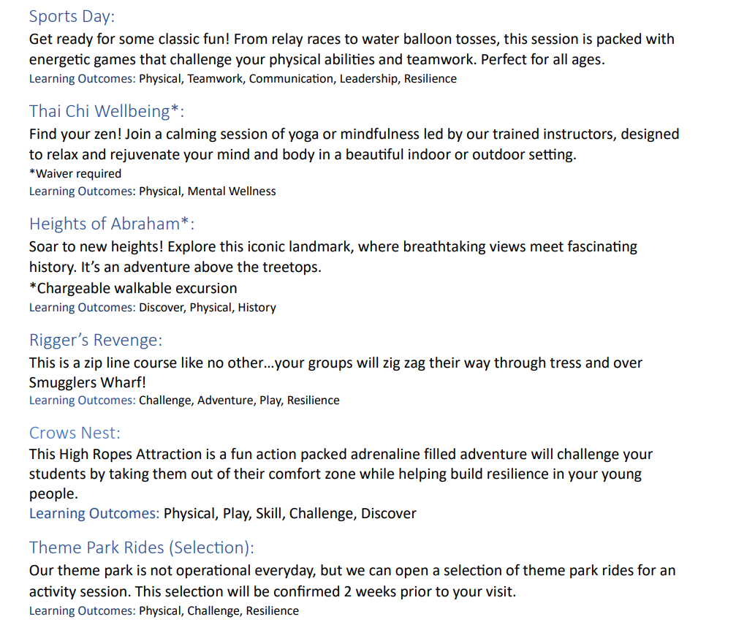
Activities

Slide 6
Meals
Please let me know if you child has any dietary requirements e.g. allergies or intolerances.
All children will select their meal options for the days we are there.
All children will require a packed lunch on Wednesday 24th June.

Slide 7
Meal Options
 | Wednesday | Thursday | Friday
Breakfast |  | Toast/ variety of cereal/ fruit/ juices | Toast/ variety of cereal/ fruit/ juices
Lunch |  | Sandwich/crisps/fruit/ biscuit Sandwiches – cheese/ham/ Tuna/ Egg Mayo | Sandwich/crisps/fruit/ biscuit Sandwiches – cheese/ham/ Tuna/ Egg Mayo
Tea | Option 1 - Chicken nuggets & fries | Option 1 - Cheese & Tomato Pizza & Fries
 | Option 2 - Tomato & Basil Pasta | Option 2 - Jacket Potato Served with Beans
Dessert | Mini Doughnuts or ice lolly | Strawberry Mousse/ Ice Lolly

Slide 8
Essential kit required
Wash kit and towel
Water bottle
Comfortable clothes/shoes that you don’t mind getting dirty
(enough for three days – and a spare incase they get wet!)
Waterproof
Sun Hat/Sun Cream
Pyjamas
Children may bring a small amount of pocket money (up to £10 maximum) for the shop which sells souvenirs and snacks

Slide 9
medications
Medication form to be completed
Medications to be bought in on the Wednesday morning – clearly labelled
First aider – Mrs Coles

Slide 10

Accommodation

Slide 11
Behaviour expectations
Children to be respectful
To listen to instructions given by school staff and park staff
To be responsible for their own property

Slide 12

Please ensure no electricals including mobile phones are brought on the trip.

Slide 13
Costings
The 2 night stay, including accommodation, meals, activities, rides and transport of £205 per child. This broken down to £175 stay £30 travel.
£20 deposit to be made by Friday 27th February 2026, which is non-refundable
Fundraising and grants are being completed – costing to decrease.

Slide 14

Question time
If you have any questions, please do not hesitate to see me

